Slide 1
Heart Disease Diagnostic Analysis
By Tarush Tanwar

Slide 2
Project Detail
Project Title | Heart Disease Diagnostic Analysis
Technologies | Data Science
Domain | Healthcare
Project Difficulties level | Intermediate
Programming Languages Used | Python
Tools used | Jupyter Notebook

Slide 3
Objective
The goal of this project is to analyse the heart disease occurrence, based on a combination of features that describes the heart disease.

Slide 4
Problem Statement
Health is real wealth in the pandemic time we all realized the brute effects of covid-19 on all irrespective of any status. You are required to analyse this health and medical data for better future preparation.
A dataset is formed by taking into consideration some of the information of 1025 individuals.

Slide 5

Architecture
Data Pre-Processing
Raw Data Collection
Importing Libraries in Jupyter Notebook
Load Dataset
Missing Value Imputations
Handling Outliers
Data Cleaning
Real World
Power BI
Desktop
Exploratory Data Analysis (EDA)
Deployment
Insights
Modelling
Reporting
Low Level Design Document
High Level Design Document
Architecture Document
Wireframe Document
Detailed Project Report

Slide 6
Dataset Information
age: The person's age in years
sex: The person's sex (1 = male, 0 = female)
cp: The chest pain experienced (Value 1: typical angina, Value 2: atypical angina, Value 3: non-anginal pain, Value 4: asymptomatic)
trestbps: The person's resting blood pressure (mm Hg on admission to the hospital)
chol: The person's cholesterol measurement in mg/dl
fbs: The person's fasting blood sugar (> 120 mg/dl, 1 = true; 0 = false)
restecg: Resting electrocardiographic measurement (0 = normal, 1 = having ST-T wave abnormality, 2 = showing probable or definite left ventricular hypertrophy by Estes' criteria)
thalach: The person's maximum heart rate achieved

Slide 7
Dataset Information
exang: Exercise induced angina (1 = yes; 0 = no)
oldpeak: ST depression induced by exercise relative to rest
slope: the slope of the peak exercise ST segment (Value 1: upsloping, Value 2: flat,
Value 3: down sloping)
ca: The number of major vessels (0-3)
thal: A blood disorder called thalassemia (3 = normal; 6 = fixed defect; 7 =
reversable defect)
num: Heart disease (0 = no, 1 = yes)

Slide 8
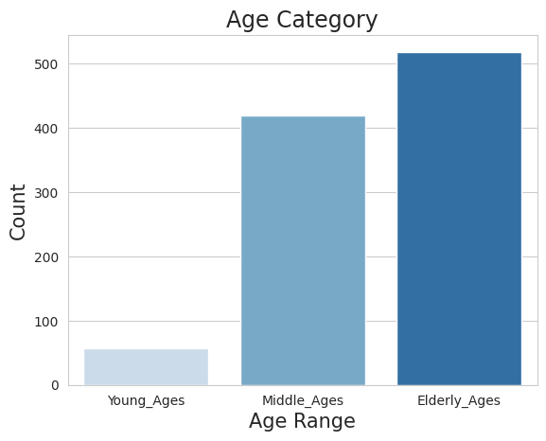
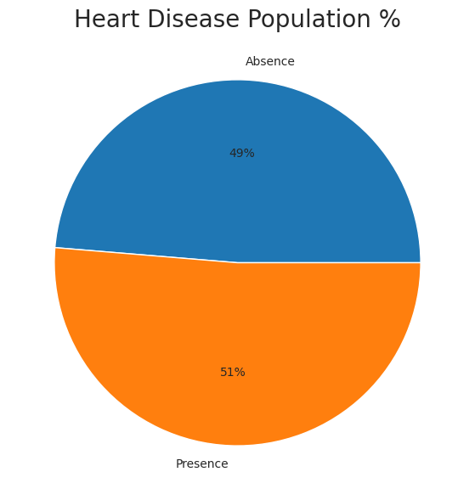
Data Analysis using Python

Slide 9
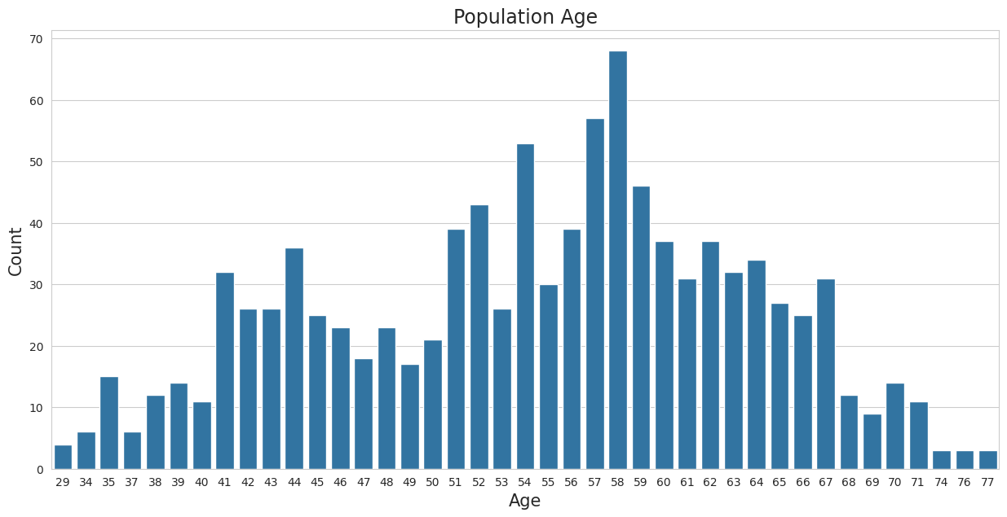
Data Analysis using Python

Slide 10
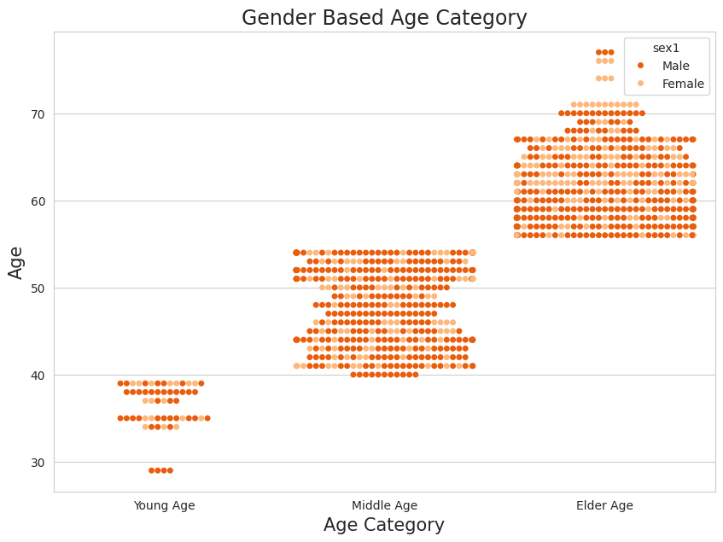
Data Analysis using Python

Slide 11
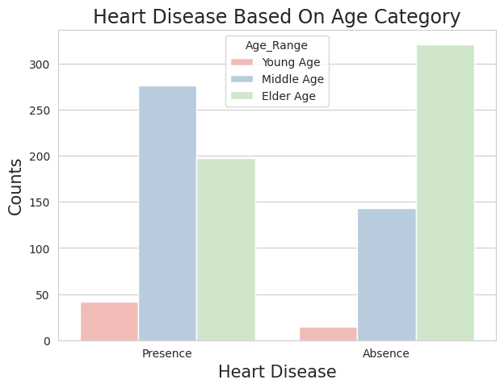
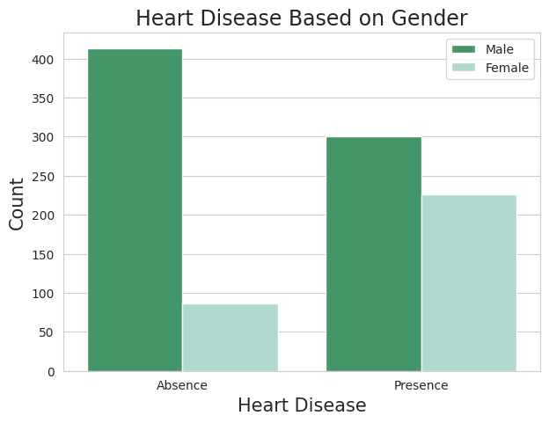
Data Analysis using Python

Slide 12
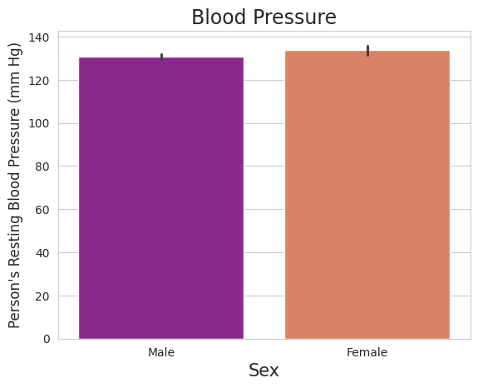
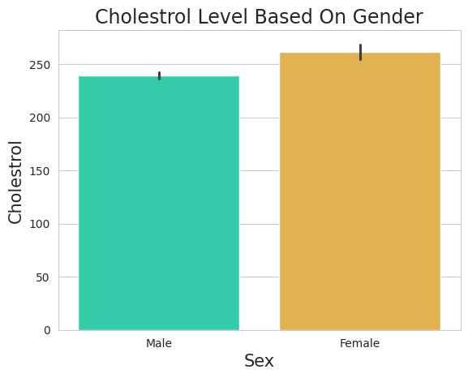
Data Analysis using Python

Slide 13
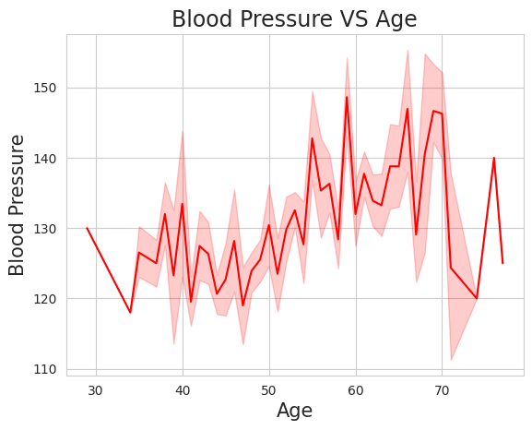
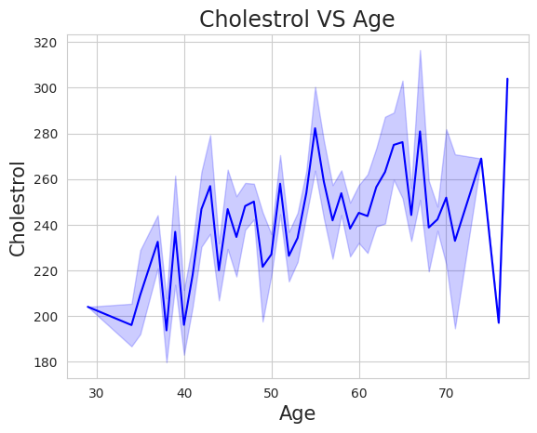
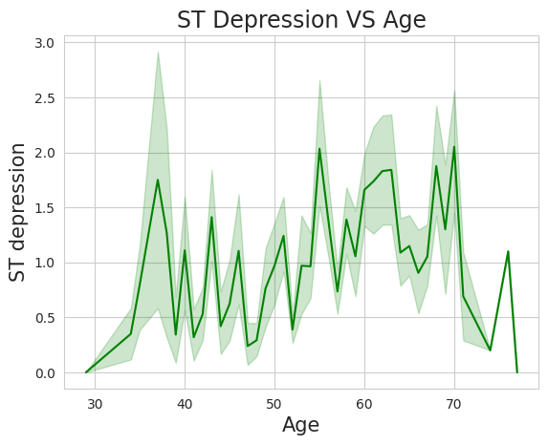
Data Analysis using Python

Slide 14
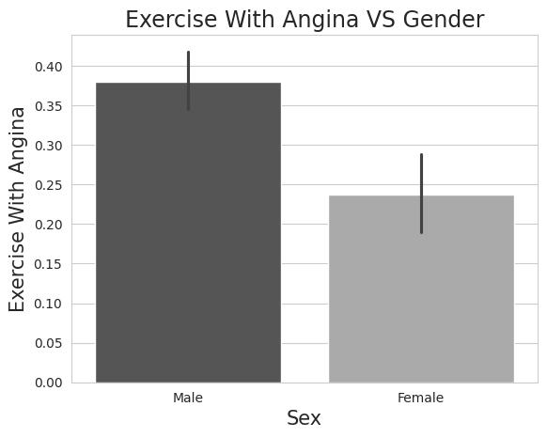
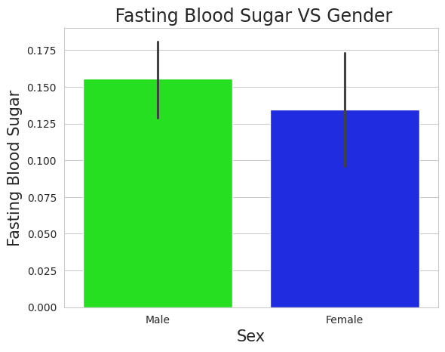
Data Analysis using Python

Slide 15
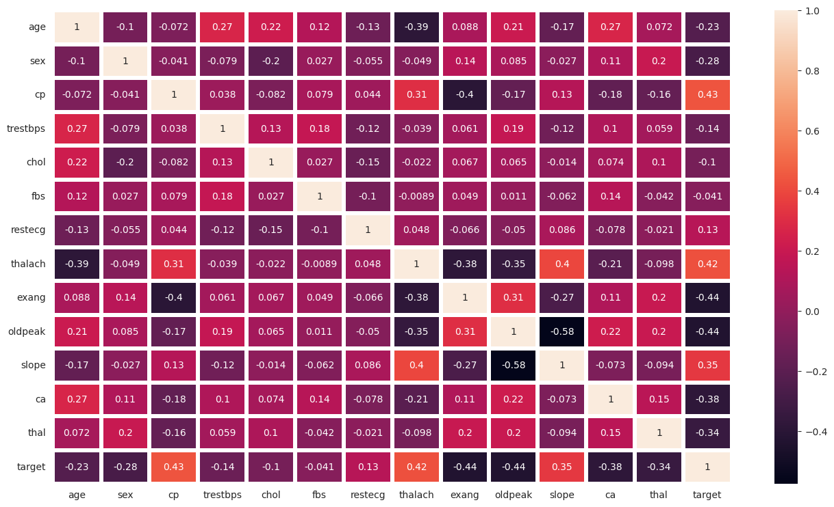
Data Analysis using Python

Slide 16
Tableau Dashboard

Slide 17
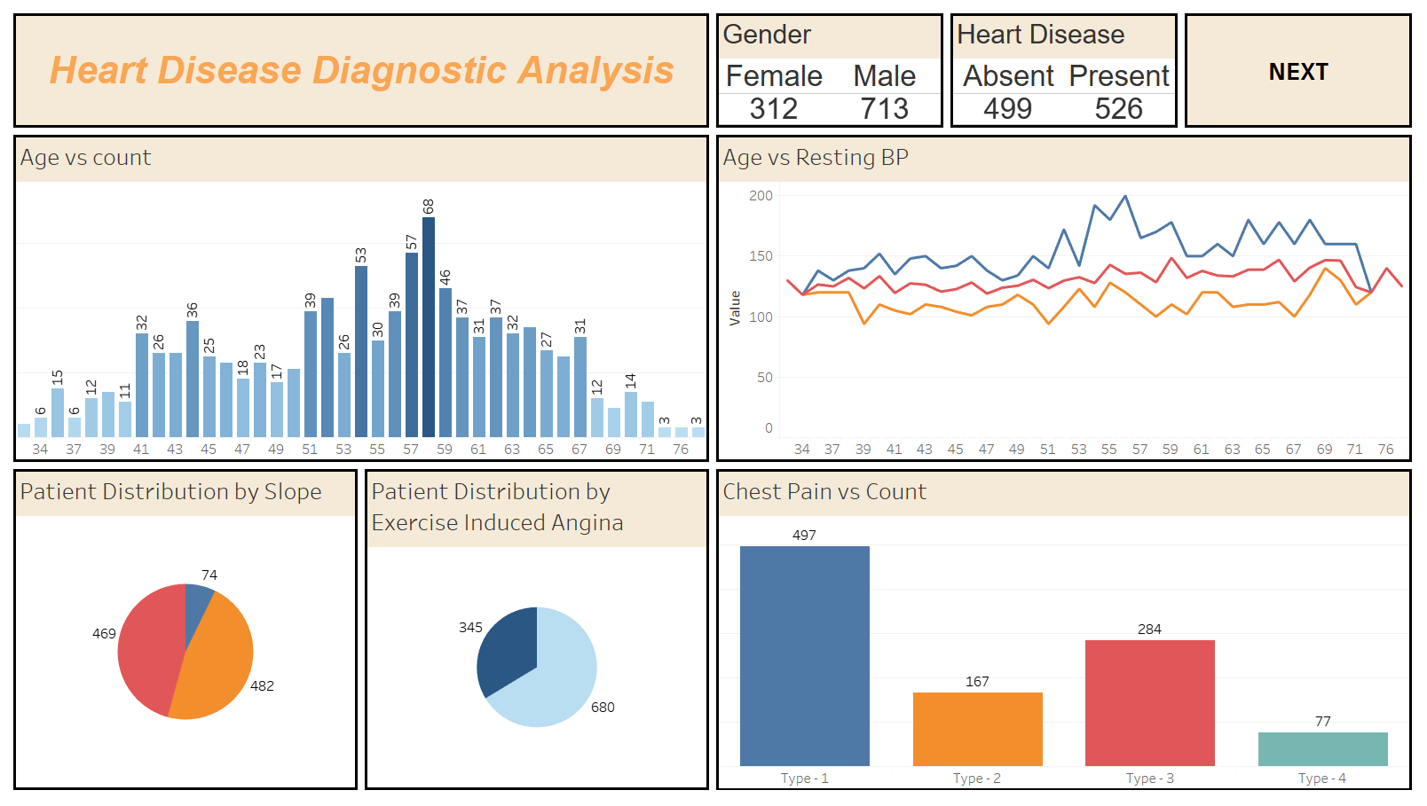

Slide 18
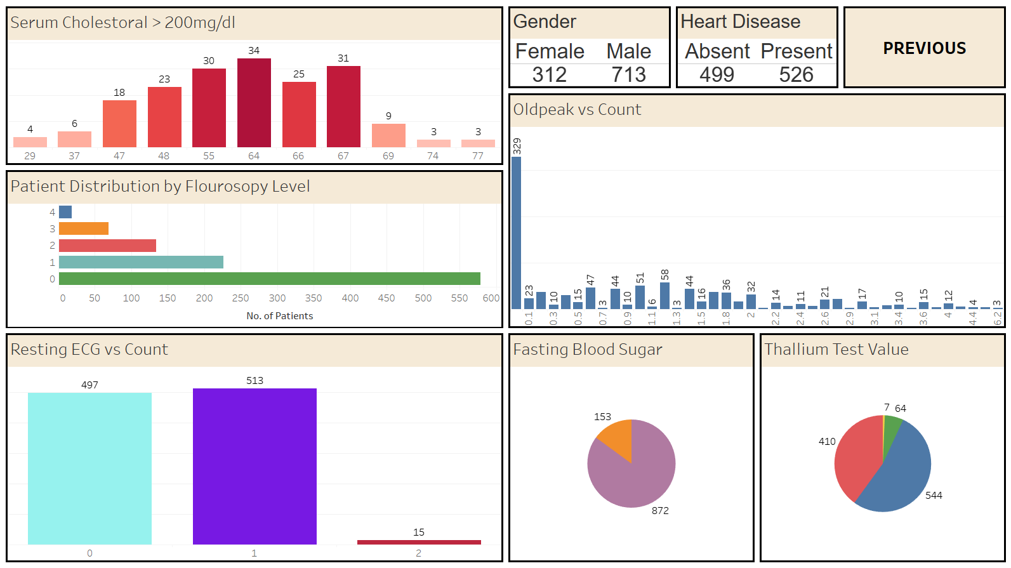

Slide 19
Insights
Out of 1025 patients, there are 312 females and 713 males, with an average age of 54.
48.5% of patients (13% females and 35.5% males) experience no chest pain.
Very severe chest pain affects 7.5% of patients (77 total, 13 females, and 64 males).
Patients aged 55-65 often have the highest resting blood pressure (diastolic over 150 mg/dl), indicating a higher risk of hypertension.
Approximately 83% of patients (853 total, 267 females, and 586 males) have serum cholesterol levels above 200 mg/dl, increasing cardiovascular disease risk.

Slide 20
Insights
Fasting blood sugar levels above 120 mg/dl are found in 15% of patients (42 females and 111 males), suggesting prediabetes or Type 2 diabetes.
Only 1.5% of patients (11 females and 4 males) show a resting electrocardiographic value of 2, indicating possible heart attack signs.
48.5% of patients have no cardiac abnormalities.
Male patients generally have better resting electrocardiographic results than female patients.
Exercise-induced angina is present in 34% of patients (74 females and 271 males).

Slide 21
Insights
Moderate ischemia (Oldpeak value of 0.8) is noted in 390 patients.
Normal slope value (1) is observed in 47% of patients, while 46% have a slope value of 2. However, 7% have a slope value of 0, indicating more severe ischemia or coronary artery disease.
Eighteen male patients have a critical fluoroscopy level of 4. Conversely, 56% have a fluoroscopy value of 0, indicating healthy heart function.
Thallium test value of 2, suggestive of decreased blood flow or scar tissue, is seen in around 93% of patients.

Slide 22
Insights
Approximately 21% of patients (105 females and 114 males) with chest pain severity of 2 are diagnosed with heart disease, with males being more prone.
About 51% of patients are diagnosed with heart disease.
Signs of heart disease are notably present in patients aged 40-45 and 50-60.

Slide 23
Thank you

